Slide 1

Happy Home
Abhiti Rachel 21104093
Urvi Joshi 21104100
Sakshi Jagtap 21104082
Prof. Shital Agrawal

Slide 2
Contents
Introduction
Objectives
Scope
Features / Functionality
Project Outcomes
Technology Stack
Block Diagram/ Flow

Slide 3
1. Introduction
Problem Statement:
There are people who have no idea where to donate and some might have no time to go to the place to give their donation's item.
Fraud issues might make some people suspicious to donate their money to the welfare homes.

Slide 4
Solution
This application is for the donors who wish to make a donation but do not know where to donate it.
Besides, to avoid fraud issues regarding stolen money or any donation item for their satisfactory.

Slide 5
2. Objectives
To ease the donors who wish to make a donation but do not know where to donate it.
To raise donations for abandoned and lonely senior citizens
To make user friendly system for volunteers
To provide emotional support to overcome social isolation.

Slide 6
3. Scope
The scope of this project are mainly focuses on the development of application for donors out there who are intended to donate things but do not have any idea where to donate it.
The donor can donate the item by clicking based on the category and search any listed welfare home.
All the old age homes are registered in the system which are associated with our site.

Slide 7
4. Feature /Functionality
1.Payment Portal :
Followed by payment gateway.
2.Location:
Provision of contact numbers.
Location of old age homes for visitors.
3.Welfare Donations:
Food
Clothes
4.User Dashboard:
User information.
5.Organize Events

Slide 8
5. Outcome of Project
The donation platform will have a user-friendly interface that allows donors to sign up and log in securely. Once logged in, they will be able to select the category of donation and choose from a list of verified welfare homes.
Donors can then add the details of their donation, including the type of item, quantity, and delivery date. The system will record all the information, including the donor's name, address, and contact details, as well as the date and time

Slide 9
6.Technology Stack
1.Tkinter:
Tkinter is one of the Python libraries which contains many functions for the development of GUI(graphical user interface) pages and windows.
2.MySql:
MySQL is an open-source relational database management system
3.Pycharm IDE:
It is a dedicated Python Integrated Development Environment. IDE provides a wide range of essential tools for python developers.
4. API
API stands for "Application Programming Interface".APIs allow different software applications to talk to each other and exchange information in a standardized and structured way, making it easier for developers to build new applications and services on top of existing ones.

Slide 10
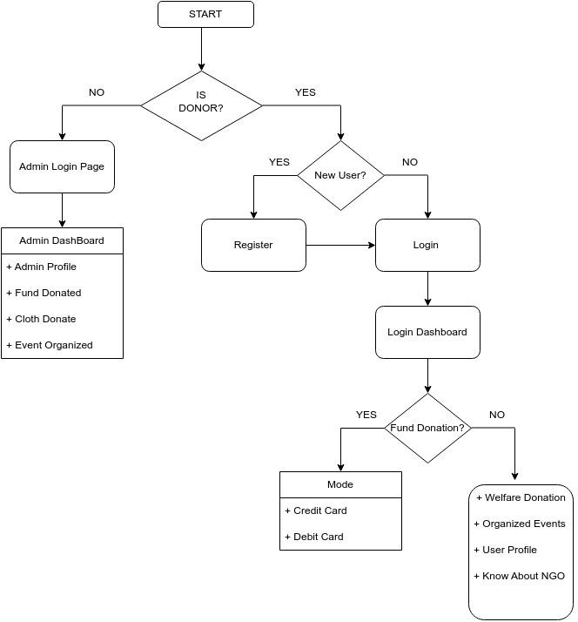
7. Block Diagram/ Flow Chart

Slide 11
Thank You...!!

